Slide 1



SWE 309
Introduction of Cloud Computing
Lab 1
Hadoop Cloud Computing
Instructor: Dr Mahdi H. Miraz, CEng
Associate Professor
Email: mahdi.miraz@xmu.edu.my
Room No.: A1 – 413

Slide 2


Outline
Install Hadoop
Install VirtualBox
Virtual Machine (include Hadoop)
Use HDFS
Use MapReduce

Slide 3

Create Azure Free Account
First Download the VirtualBox Oracle from the below link:
https://www.virtualbox.org/

Slide 4
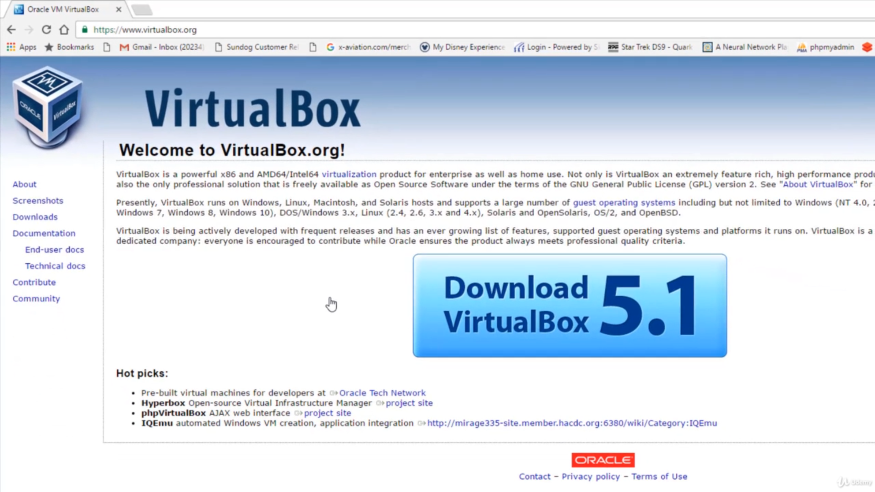
Installing VirtualBox

Slide 5
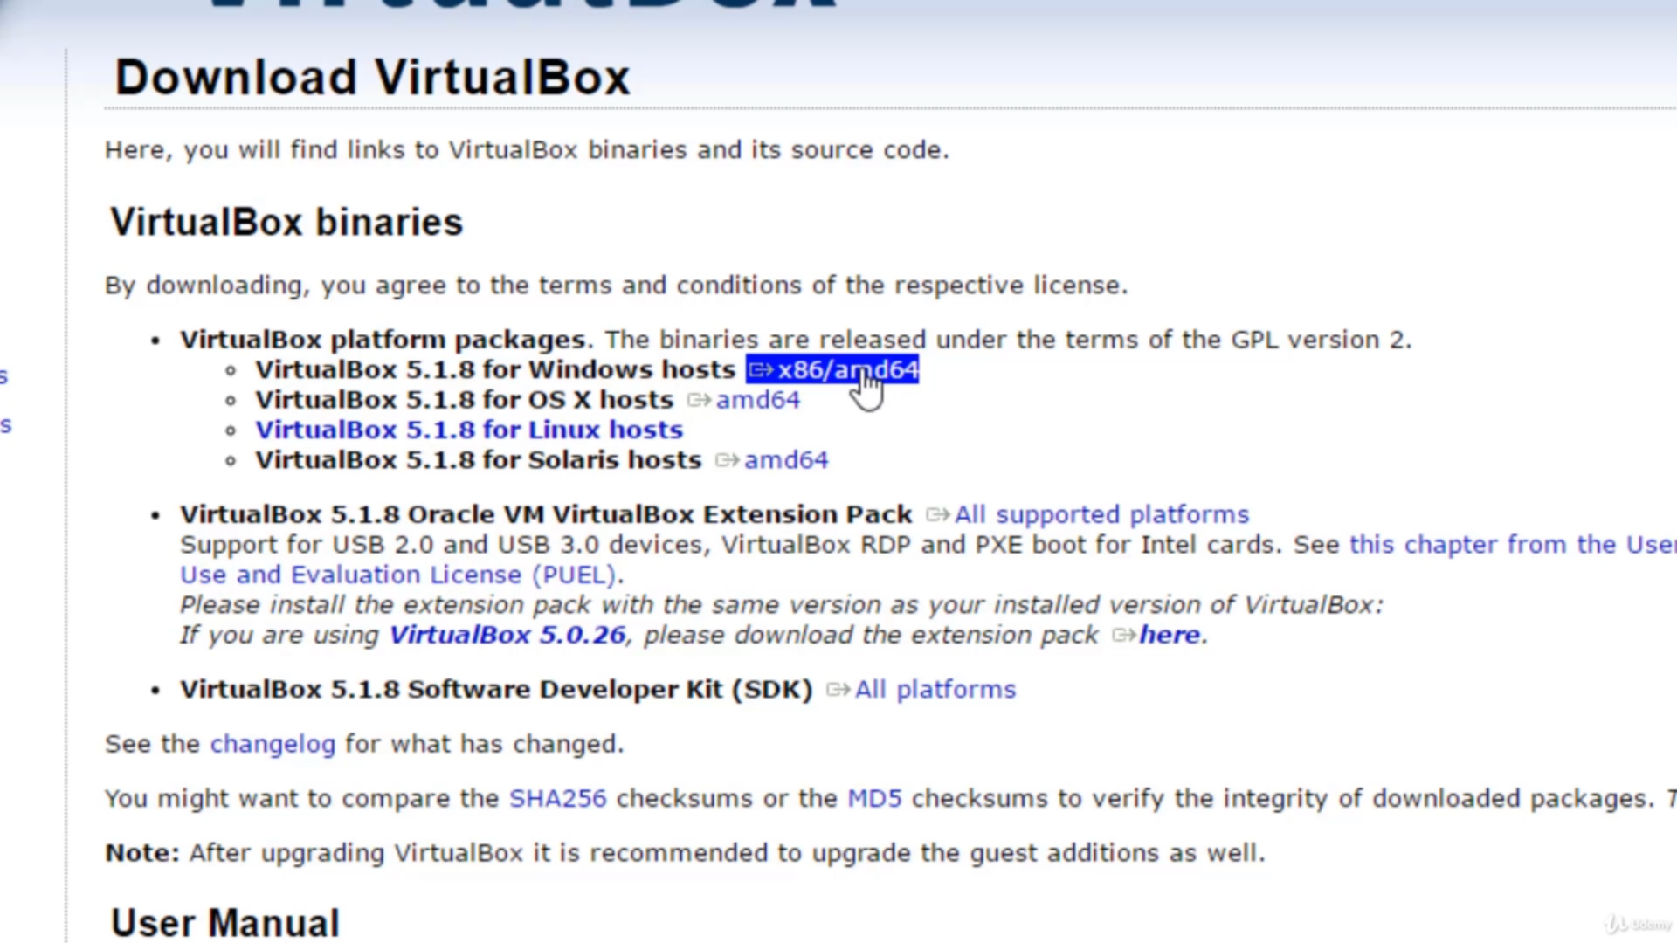
Installing VirtualBox

Slide 6
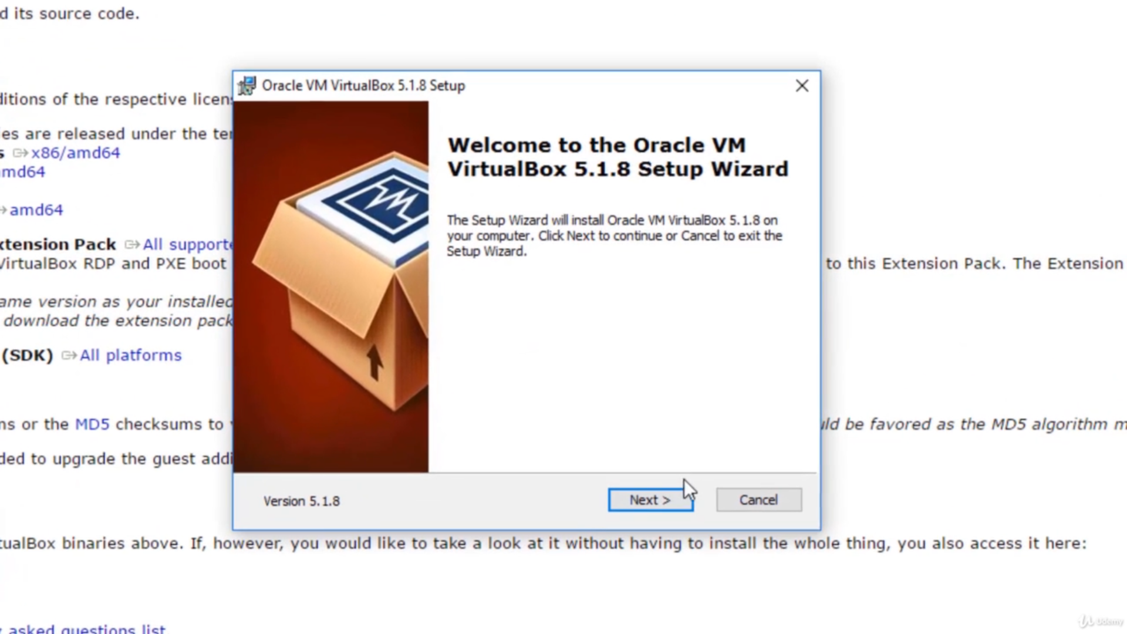
Installing VirtualBox

Slide 7
Download Virtual Machine
Then download the virtual machine from the below link:
https://archive.cloudera.com/hwx-sandbox/hdp/hdp-2.6.5/HDP_2.6.5_virtualbox_180626.ova

Slide 8
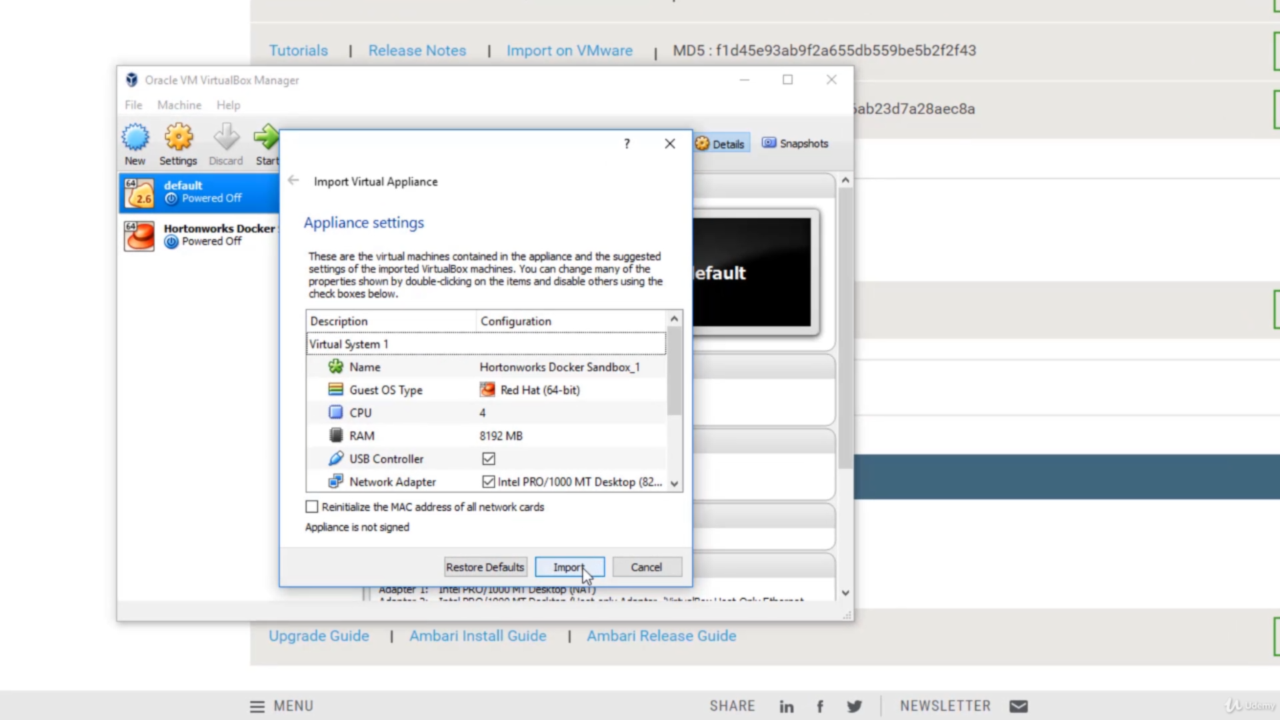
Import VM to VirtualBox

Slide 9
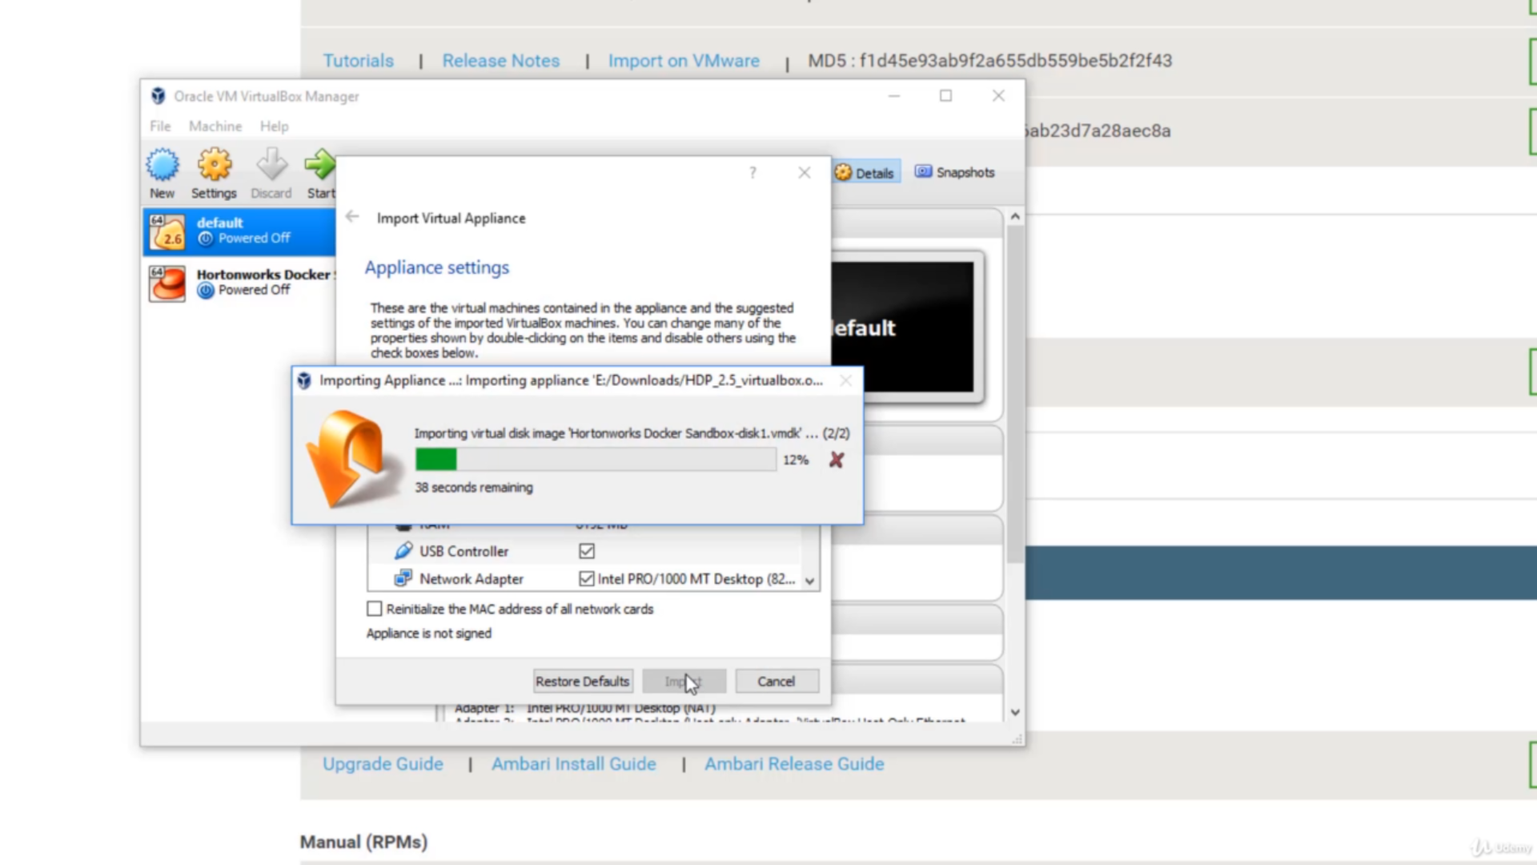
Import VM to VirtualBox

Slide 10
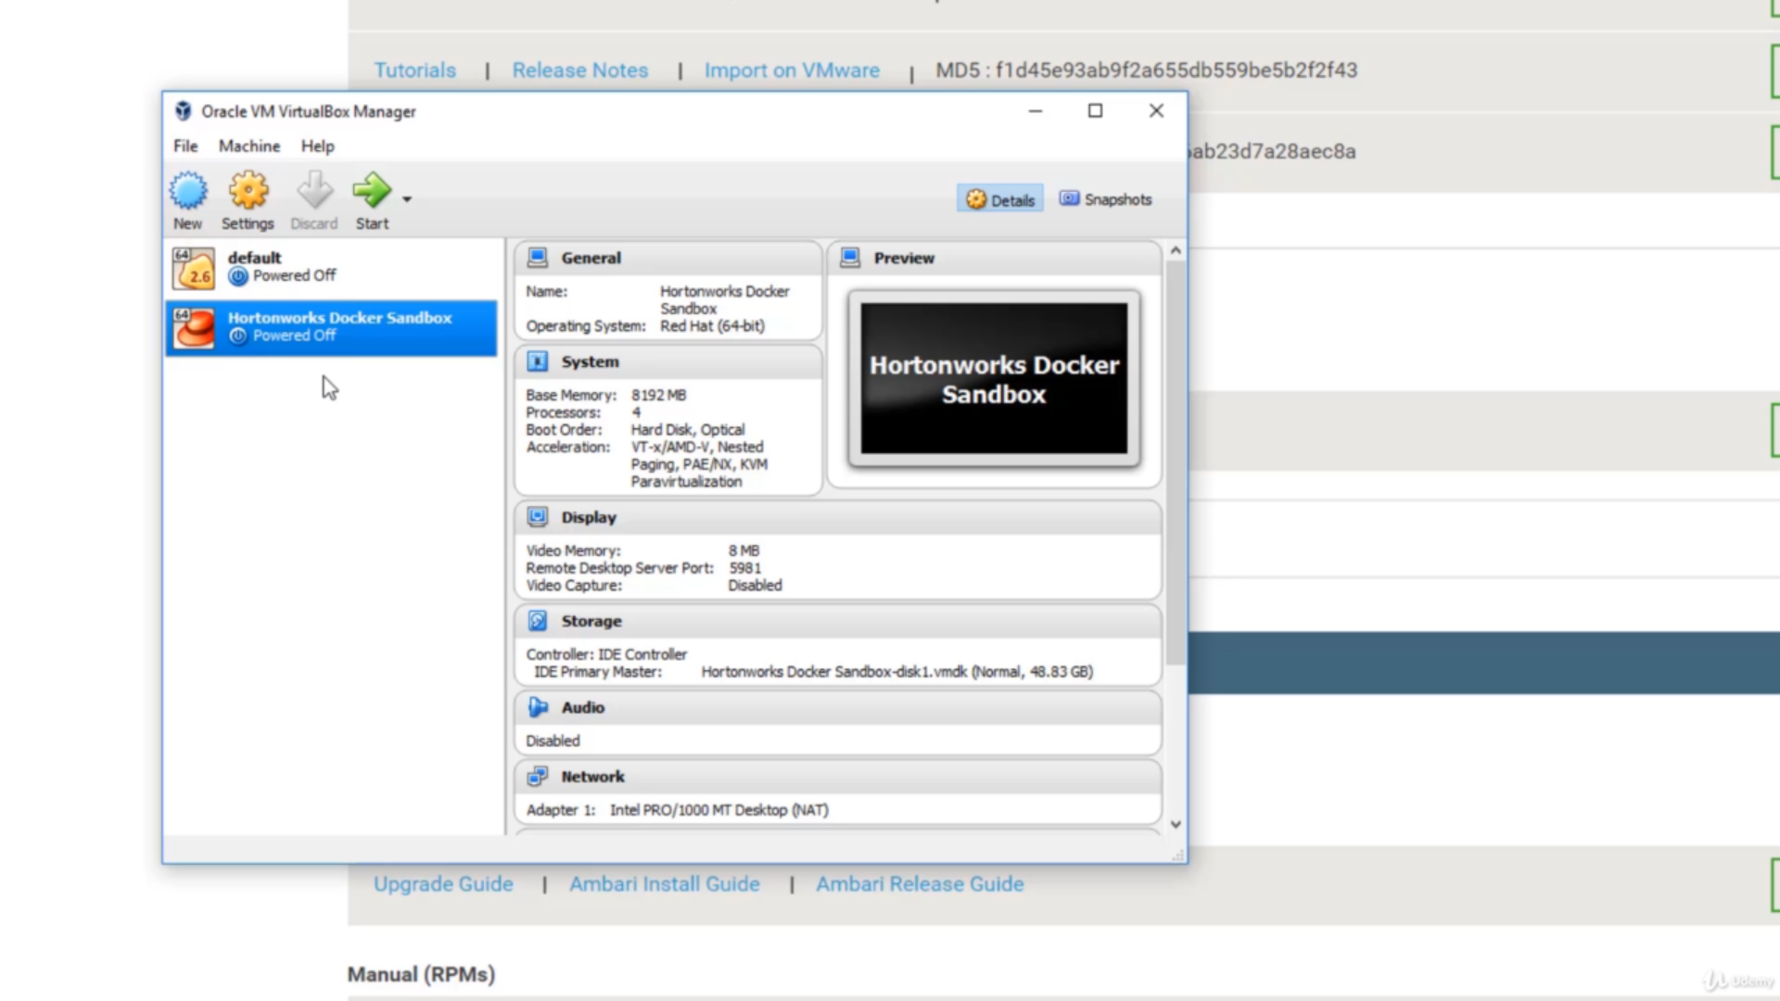
Import VM to VirtualBox

Slide 11
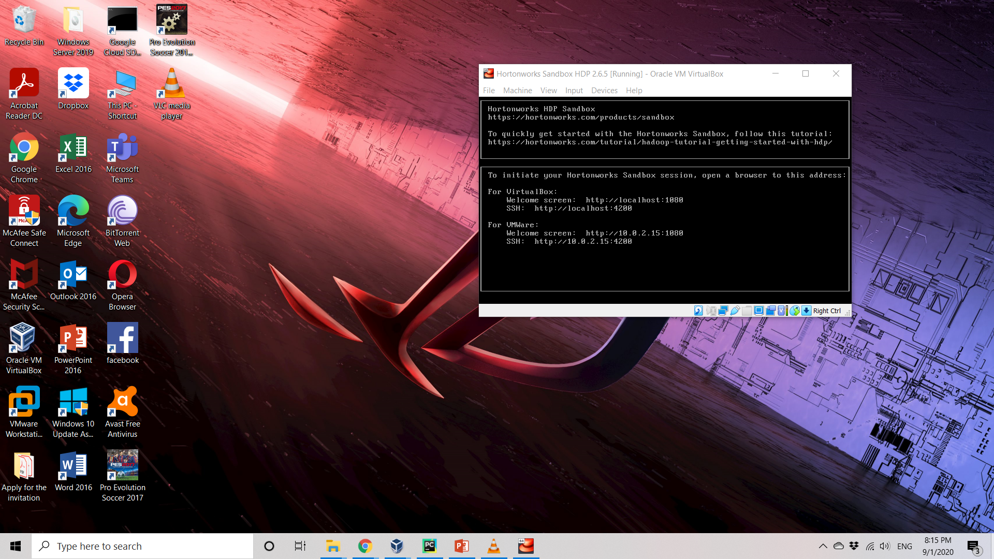
Run VM

Slide 12
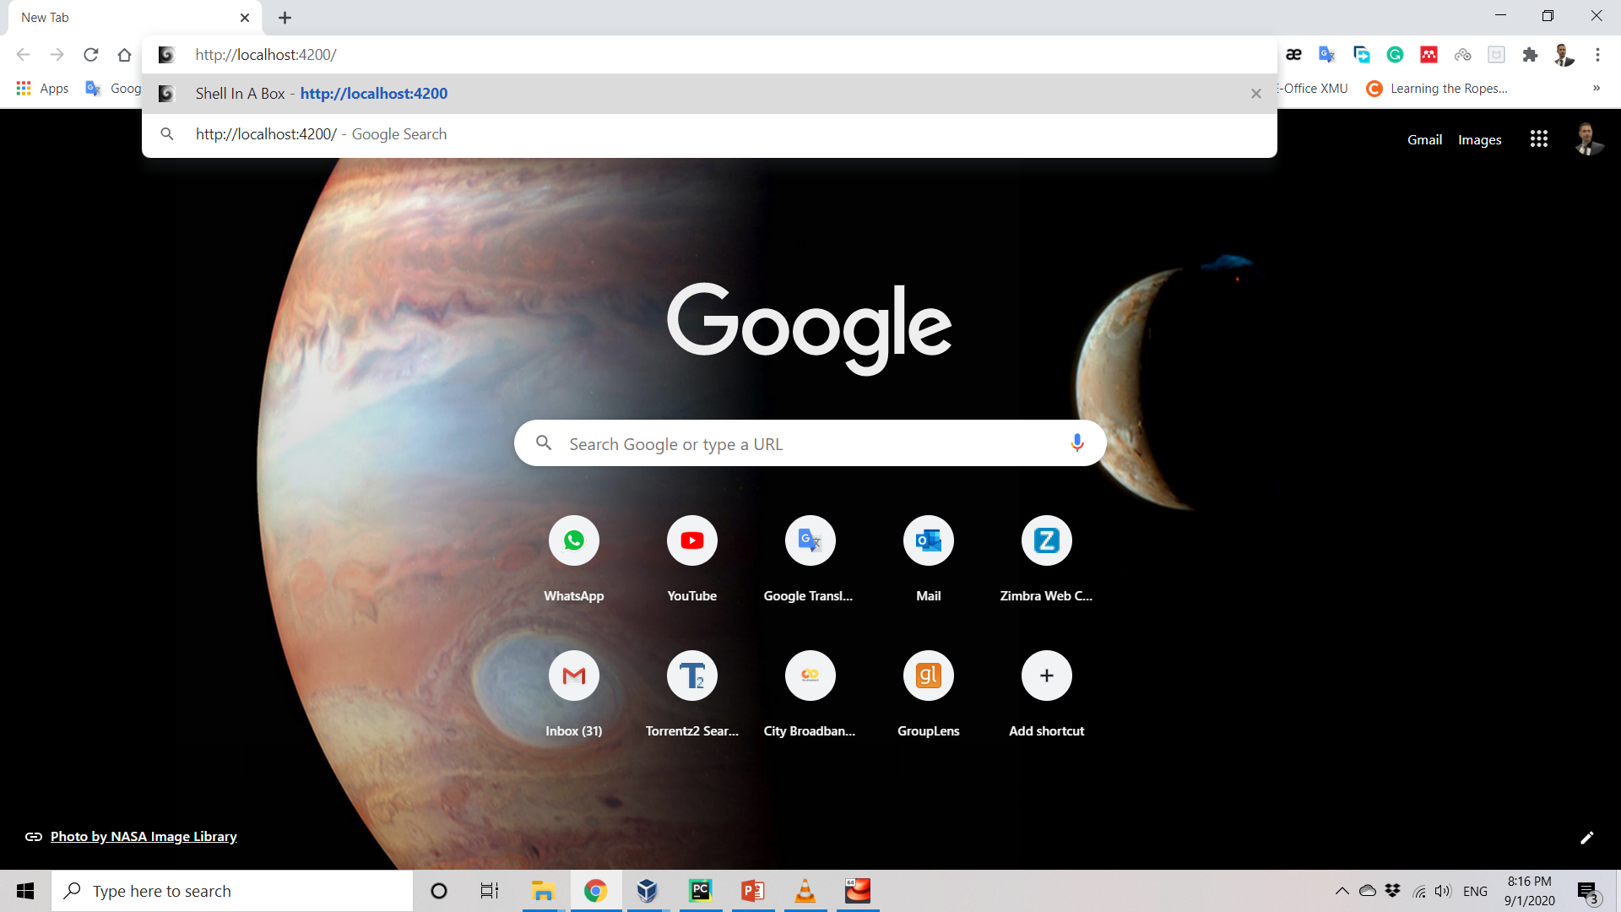
Access to VM

Slide 13
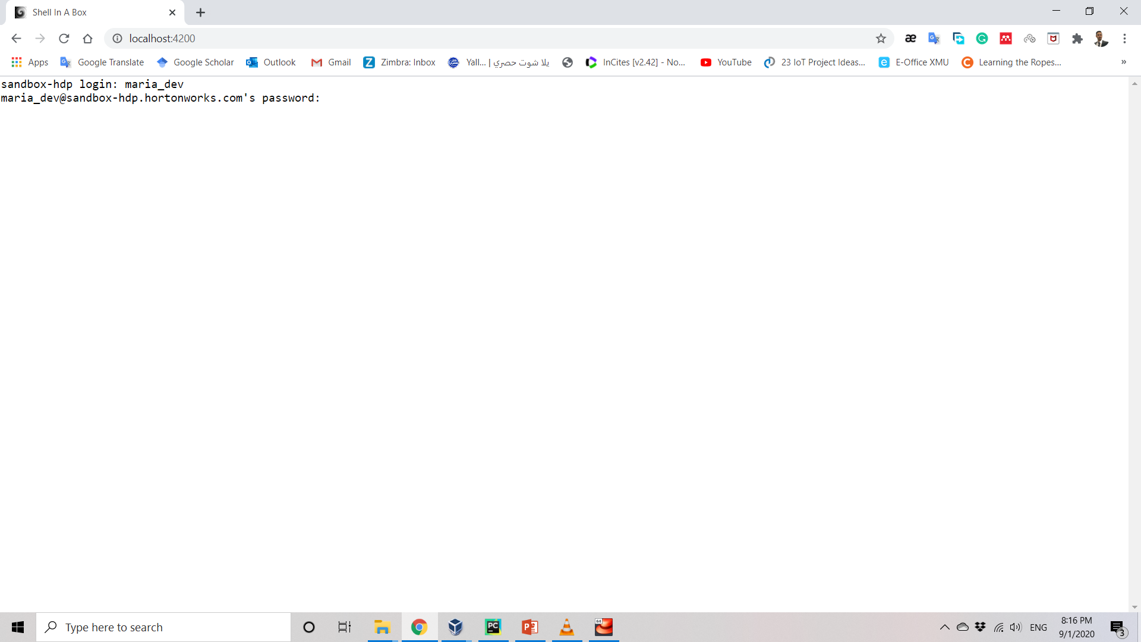
Access to VM
Notes:
default password is “hadoop”.

Slide 14
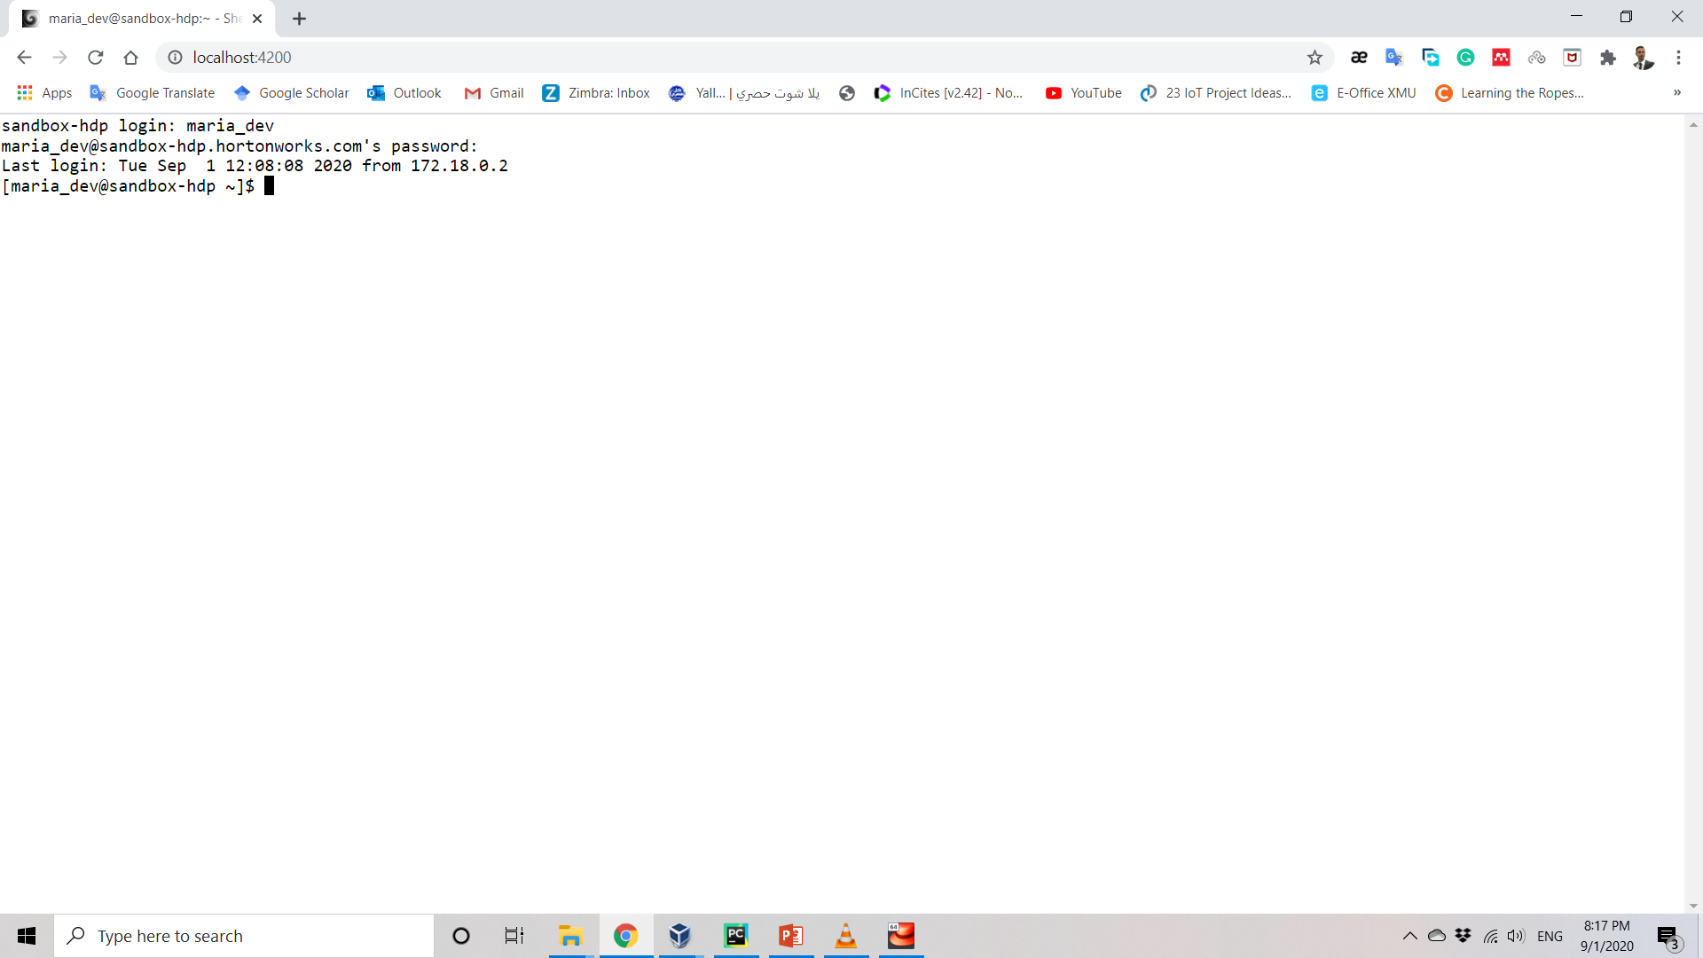
Access to VM

Slide 15
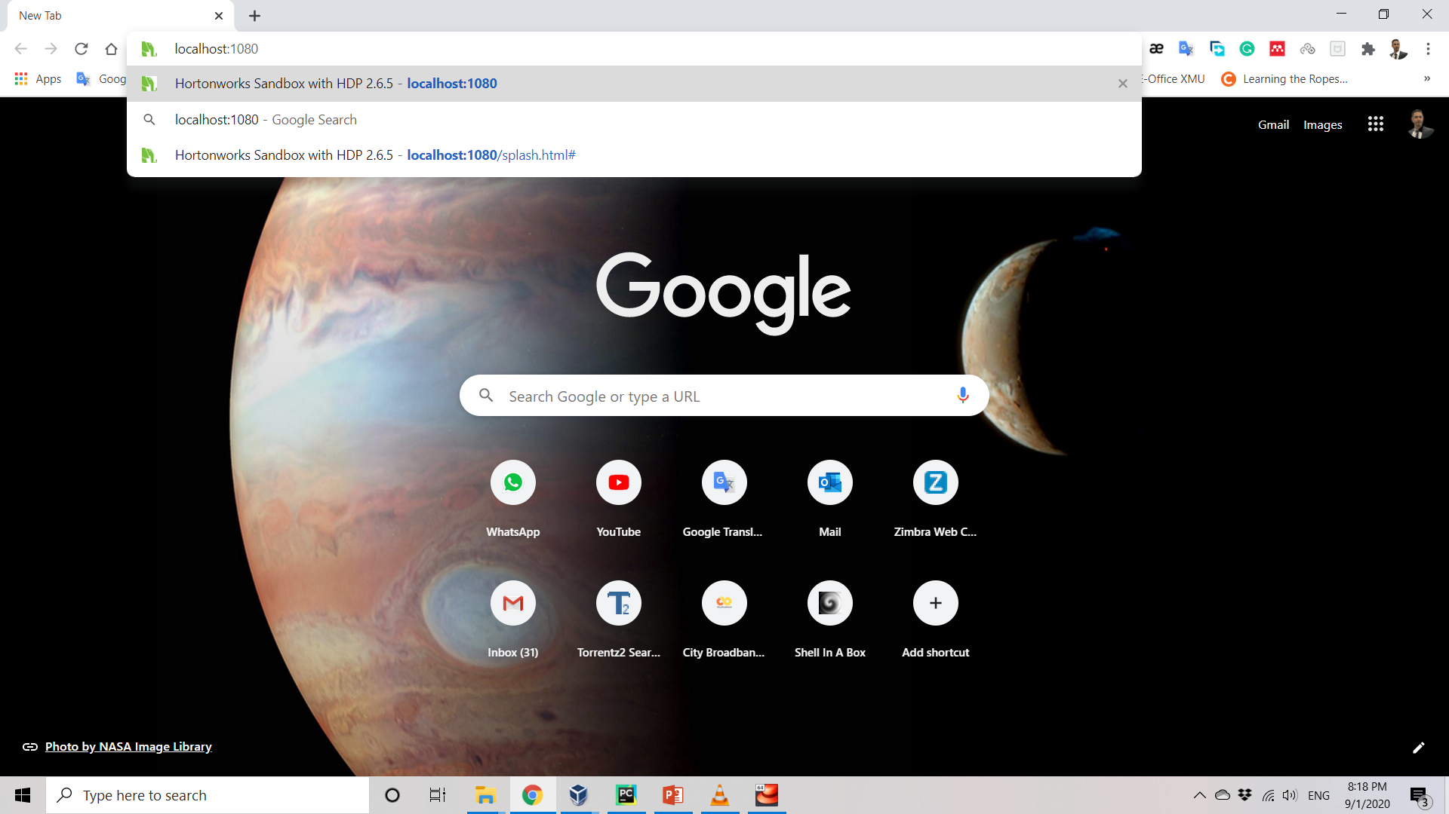
Access to VM

Slide 16
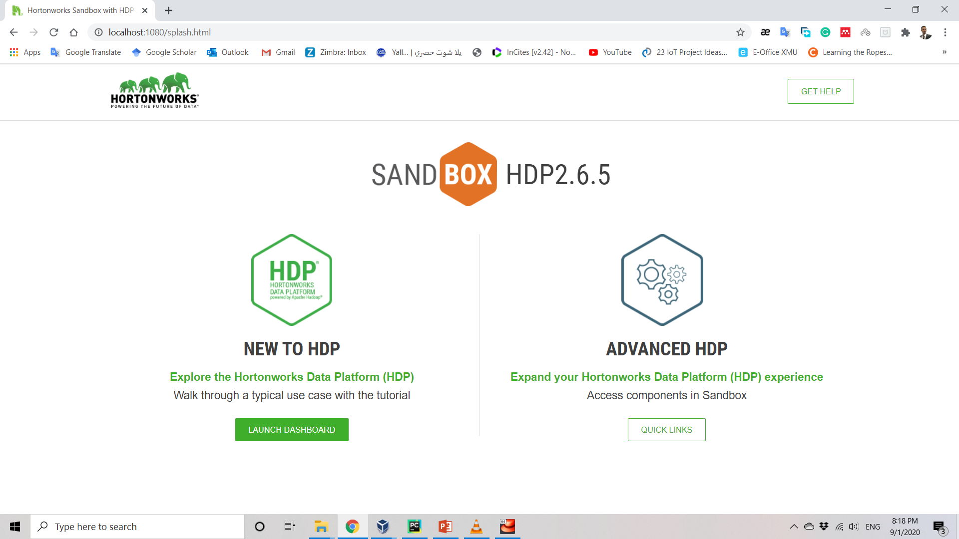
Access to VM

Slide 17
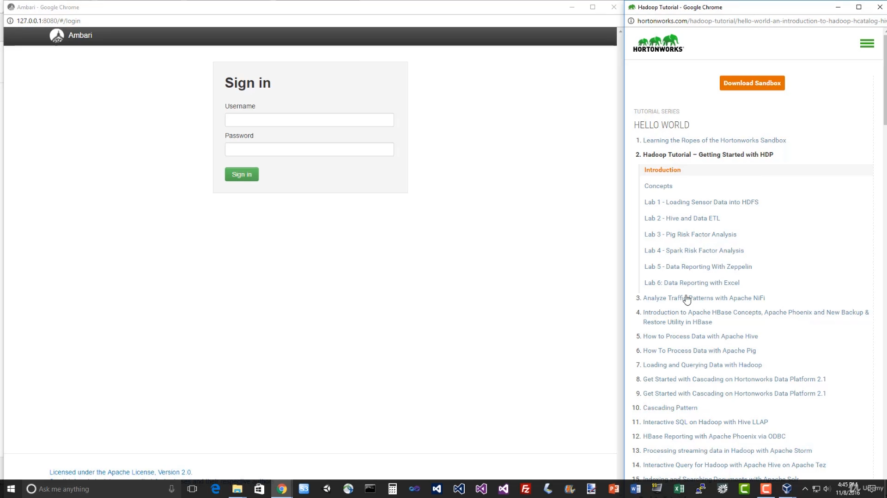
Access to VM

Slide 18
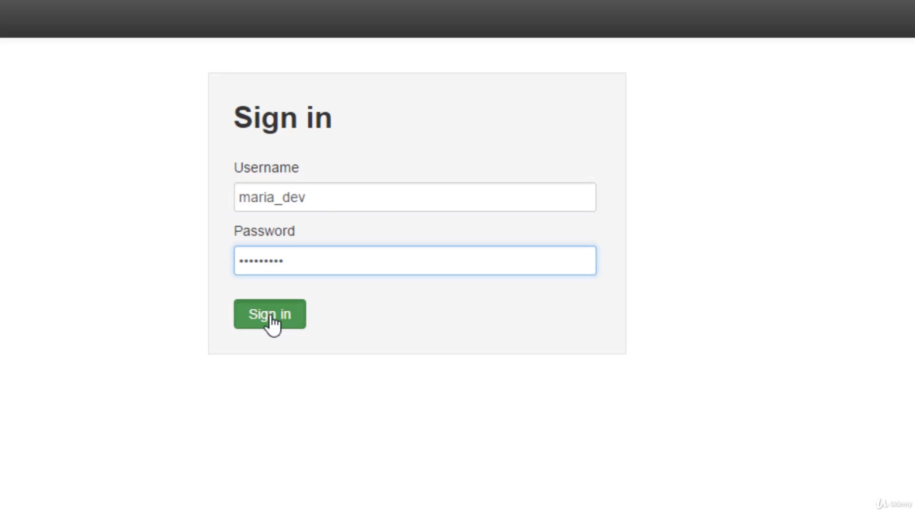
Access to VM
Username: maria_dev
Password: maria_dev

Slide 19
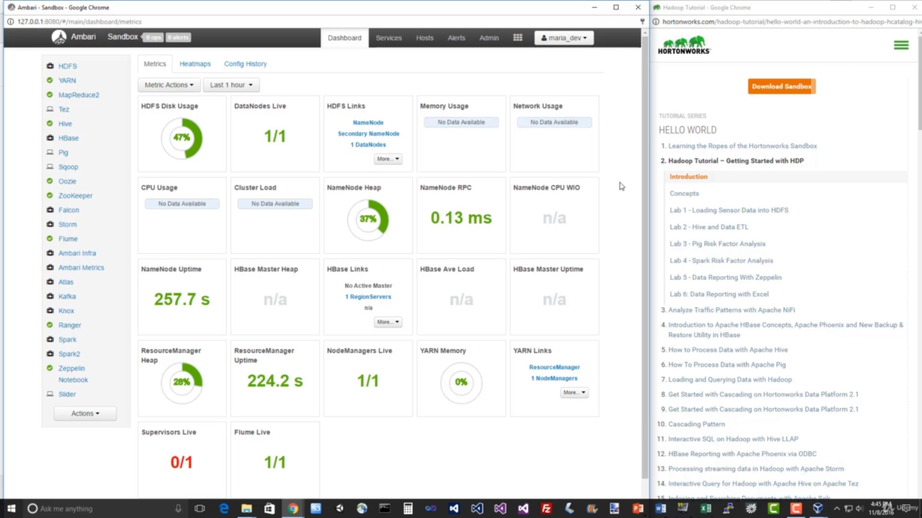
Dashboard of VM

Slide 20
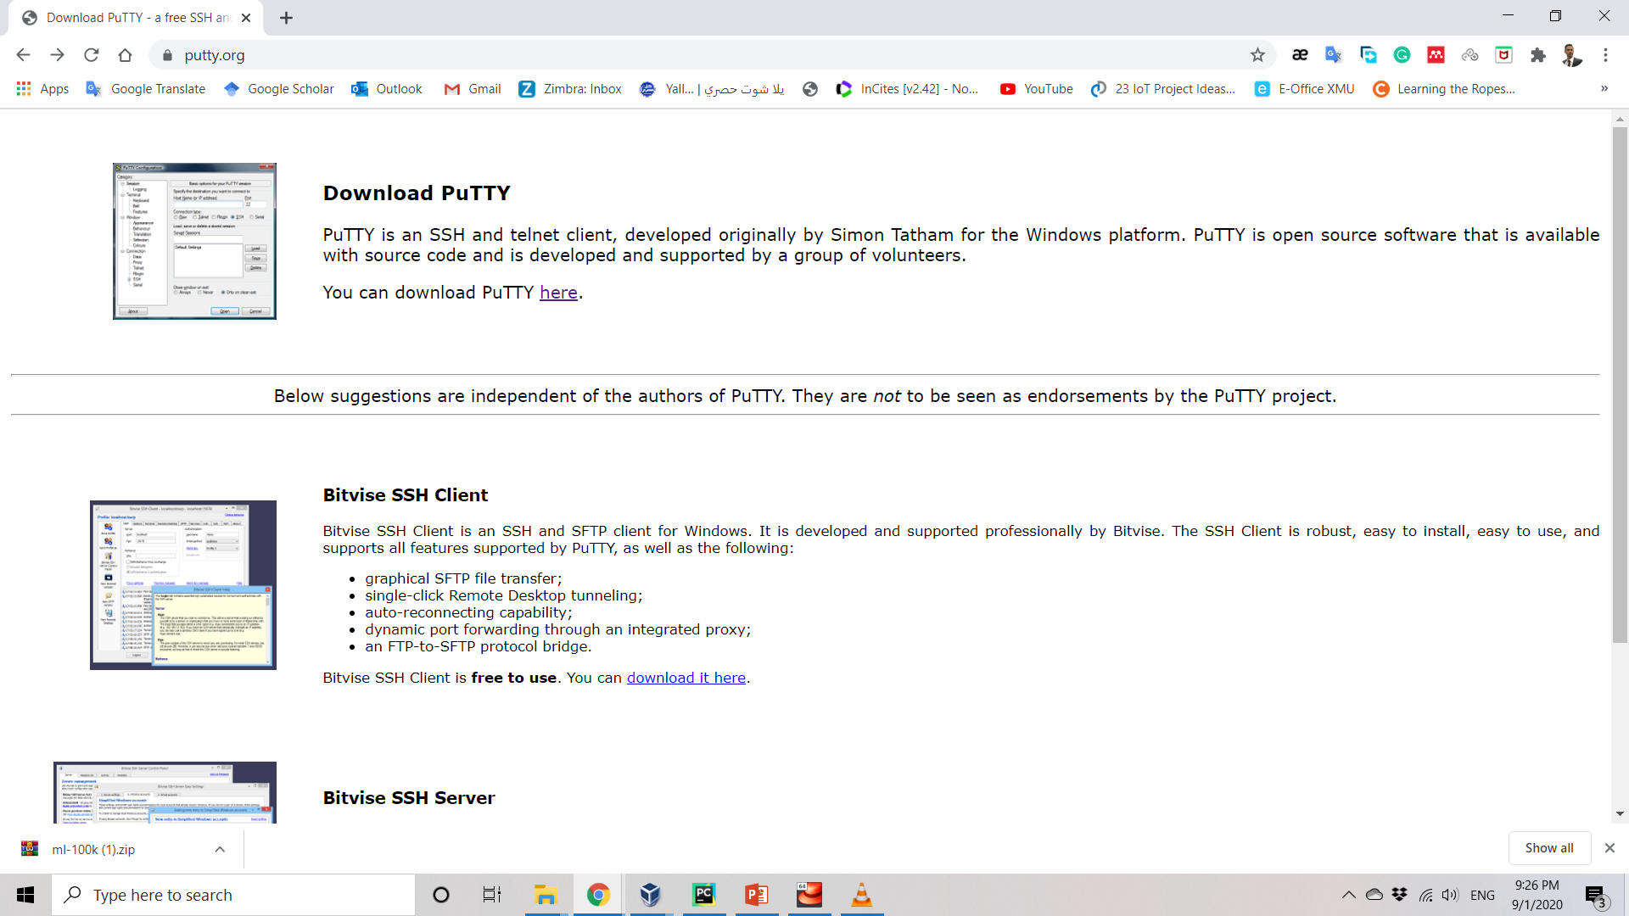
Download PuTTY

Slide 21

Use PuTTY to Access VM
PuTTY is a free and open-source terminal emulator, serial console and network file transfer application.
It supports several network protocols, including SCP, SSH, Telnet, rlogin, and raw socket connection.
It can also connect to a serial port.
The name "PuTTY" has no official meaning.

Slide 22
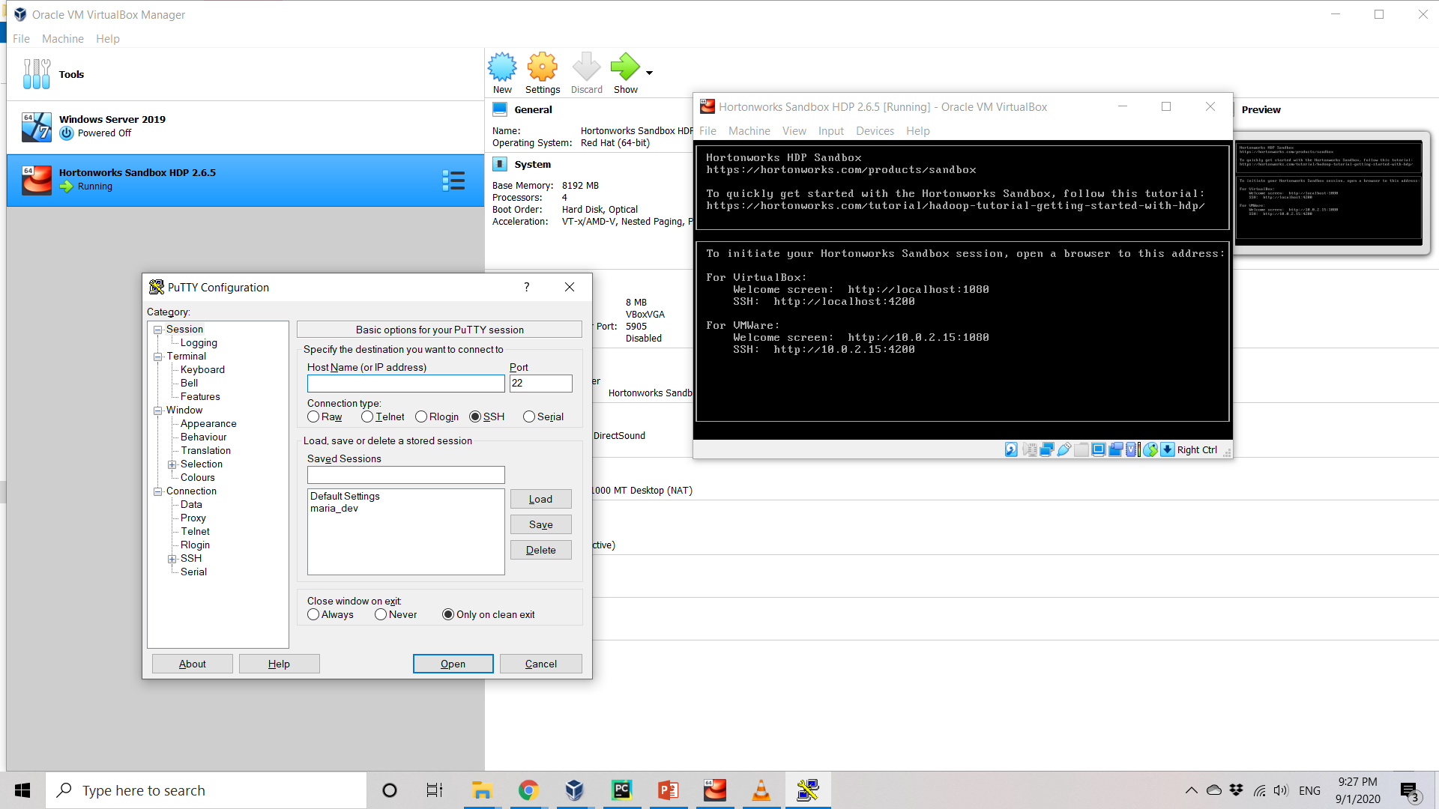
Use PuTTY to Access VM

Slide 23
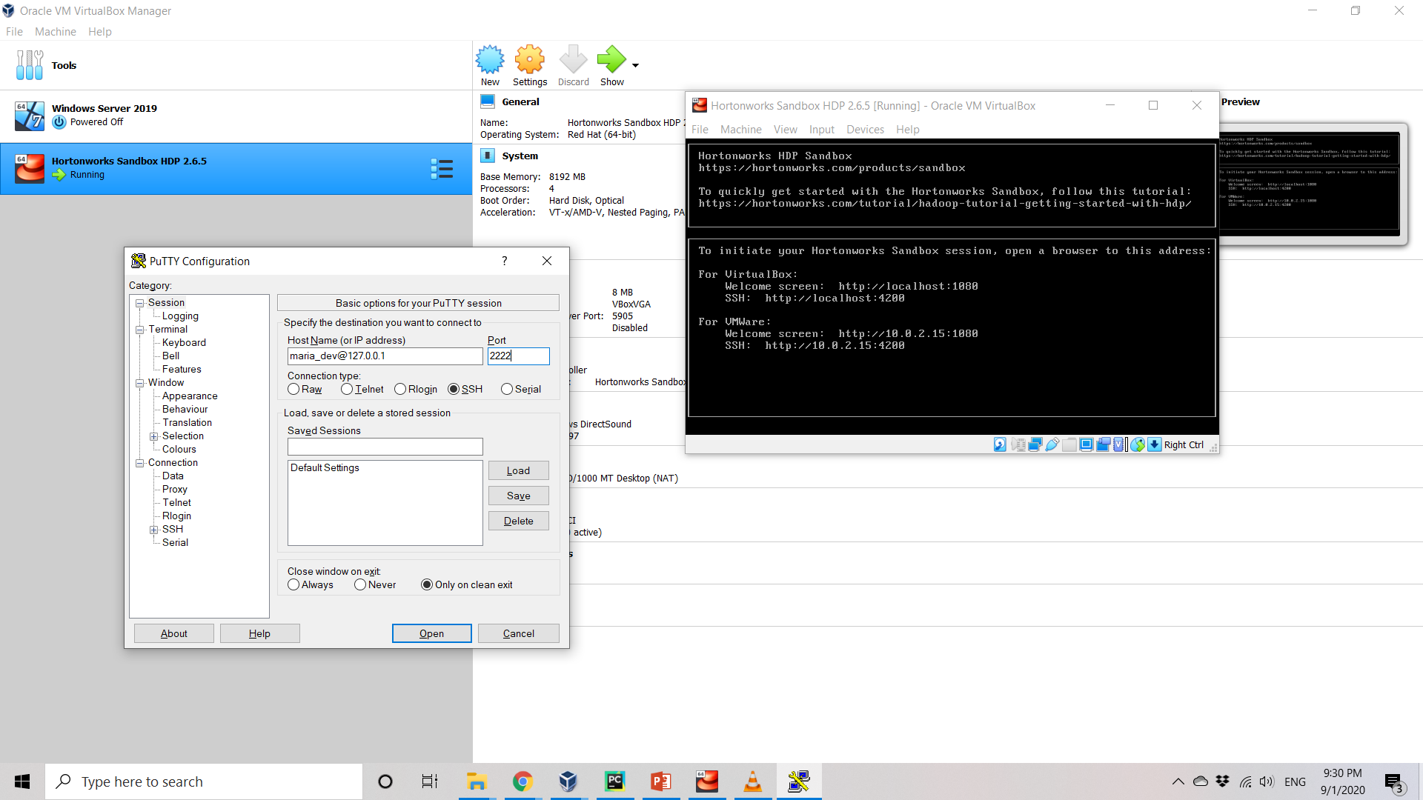
Use PuTTY to Access VM

Slide 24
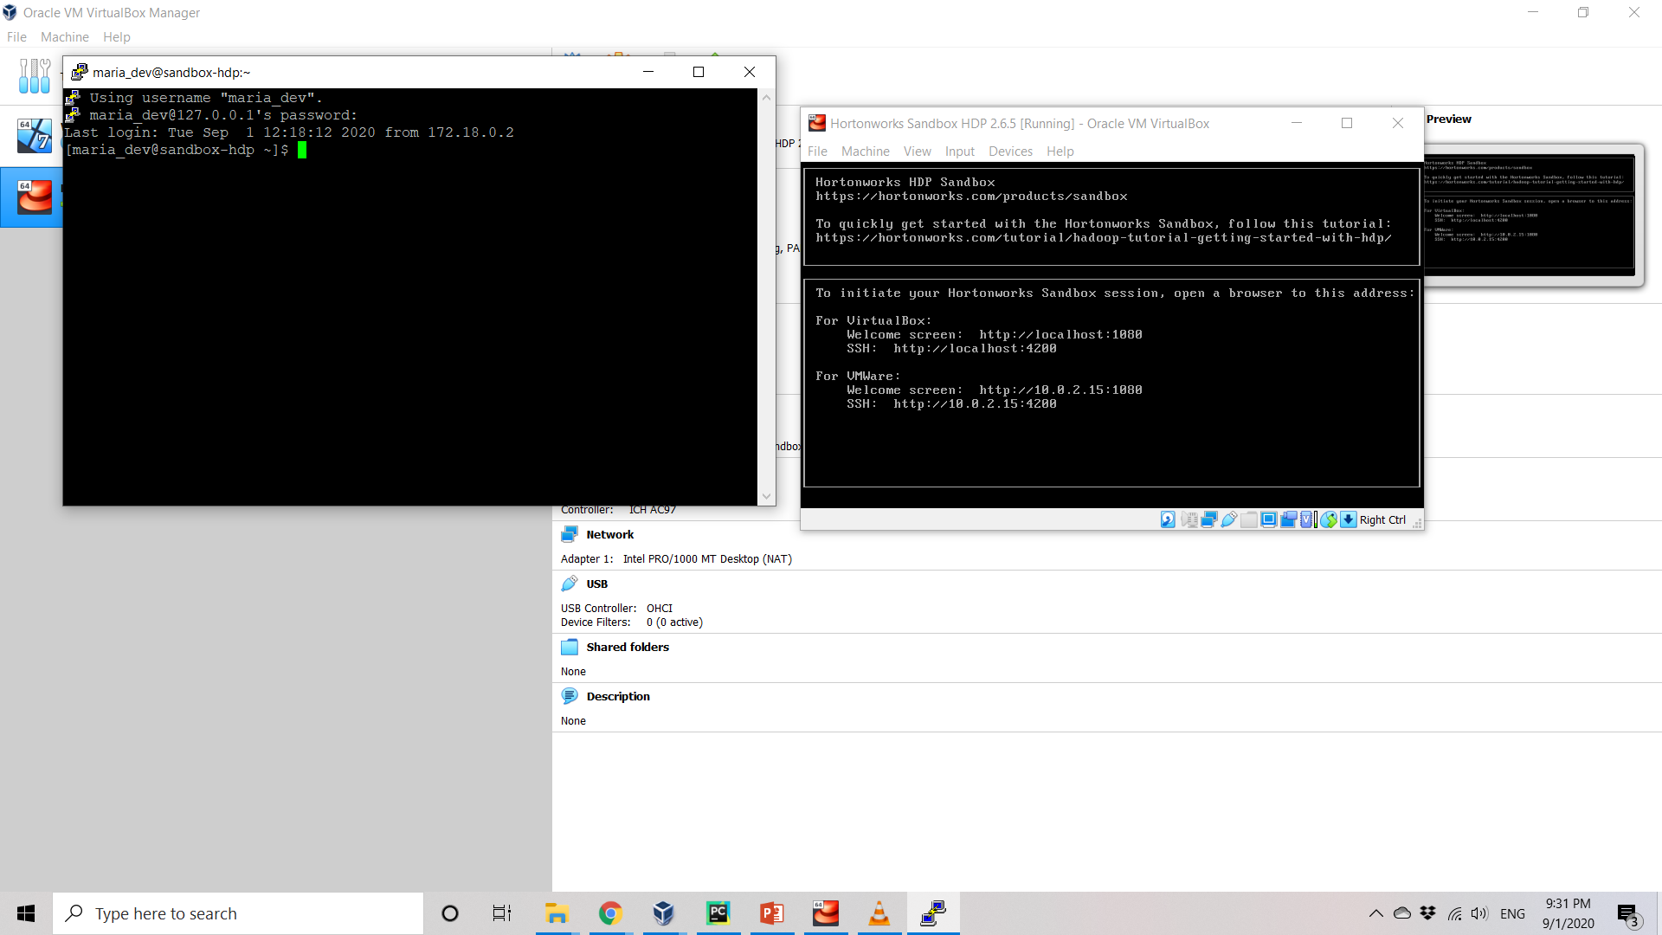
Use PuTTY to Access VM

